Slide 1
Statistics in Sports: Introductions
Zachary Binney, PhD MPH
Oxford college of emory university
Fall 2023

Slide 2
Roadmap
1. Introduction (Me)
2. Introductions (You)

Slide 3
Introduction (Me)

Slide 4
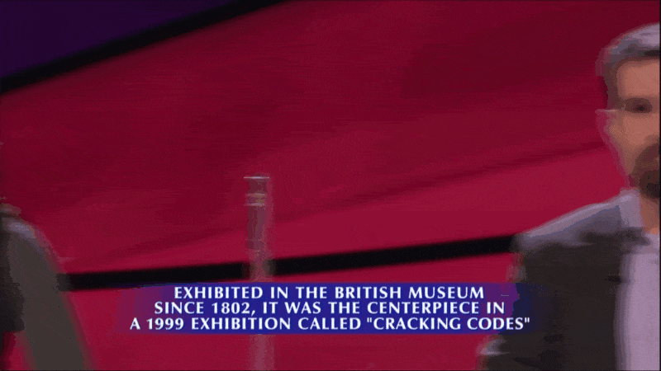
Who Am I?
PhD, Epidemiology, Emory, 2018
Assistant Professor of Quantitative Theory and Methods
Past: Adjunct Instructor at Emory and GSU
Statistical consultant for sports (NFL/MLB/NBA/NCAA) teams, pharmaceutical companies, media outlets
Past: healthcare consultant, end-of-life care
Staff Writer, FootballOutsiders.com
Been on Jeopardy!
...lost on Jeopardy!

Slide 5

Epidemiologists...They hunt viruses, right?
Source: https://lh3.googleusercontent.com/proxy/I8n7fzo7Q9XdWu1d0s1cyFj1eIuZGIz7_BjT9wtHHH1g3XZjffiATTjAHo-LPKh3cut8xqvtaG57zdoacmCQdH58l2xvQbCyl_wi7y62KeXizMB4

Slide 6

What is Epidemiology: Dictionary Definition
Epidemiology is the study of the distribution and determinants of health-related states or events in specified populations, and the application of this study to the control of health problems. (Last, Dictionary of Epi)
Source: https://www.youtube.com/watch?v=L6KB8WvtWPc

Slide 7
What is Epidemiology: My Definition
Epidemiology teaches you how to ASK and ANSWER questions about the world around you using rigorous, mostly quantitative, methods

Slide 8
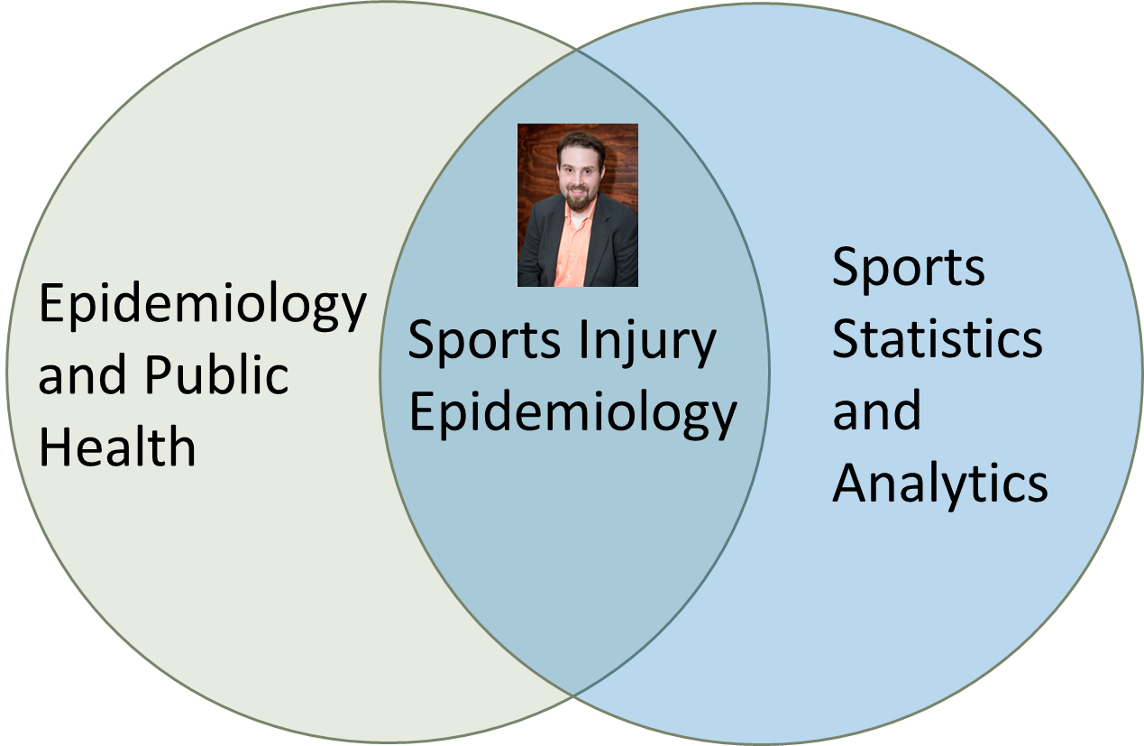
Sports Injury Epidemiology
Notes:
How many of you here are NFL football fans?
[Assuming few hands go up] Great, I love a challenge. One of my goals today is going to be to convince every one of you football and other sports injuries are an interesting and worthwhile topic to study.

Slide 9
My Journey to Sports Statistics
‘04-08: Undergrad
‘13-14: Palliative care research
‘14-18: PhD, public writing, consulting, shift to sports
‘08-11: Healthcare consultant
‘11-13: MPH, palliative care research
’18-20: Freelance sports, pharma, media consulting
’20-Now: Teach at Oxford; continue academic research agenda in sports injuries

Slide 10
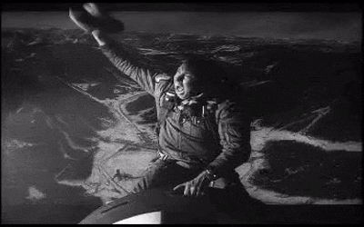
My Journey to Sports Statistics
2008: Graduate with Bachelor’s in “History, Philosophy, and Social Studies of Science and Medicine” (HiPS)
Straight into the Great Recession
Source: https://thumbs.gfycat.com/AmusedPoliticalDeermouse-size_restricted.gif

Slide 11

My Journey to Sports Statistics
2008-11: Healthcare consultant for The Advisory Board Company in D.C.
“Countercyclical investment” saved my butt
Told hospitals what cancer technologies to invest in
Paid off student loans
My mother was dying of cancer
Coping through research

Slide 12
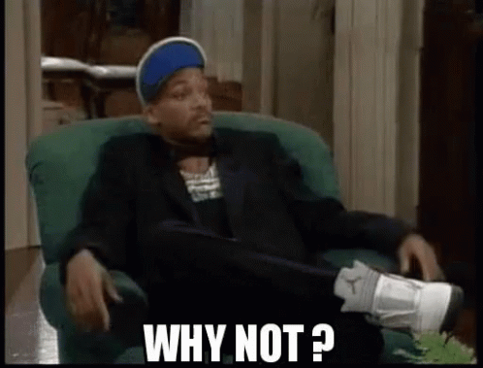
My Journey to Sports Statistics
2011: I’m 24 y/o, tired of helping hospitals make money off cancer patients. What now?
Grad school, obviously
Read The Hot Zone as a teen, epidemiology always sounded interesting
Took an undergrad course in it, “got it,” meshed well with how my brain worked
MPH in Epi-> do the quant stuff I was doing, but for good
Focus on palliative & end-of-life care
Source: https://media1.tenor.com/images/1344f37f50818e92cf936778d56b3d62/tenor.gif?itemid=13653940

Slide 13
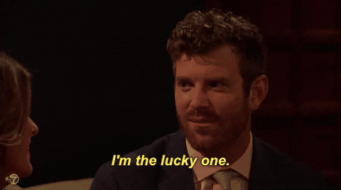
My Journey to Sports Statistics
2011-13: MPH in Epi, Emory
Worked at Emory Palliative Care Center (EPCC)
May 2013: applied on a lark for internship with Jacksonville Jaguars; became freelance injury analyst
How did I get into sports? Incredible luck, privilege
2013-14: EPCC, paid off student loans
Started managing data, writing at Football Outsiders (FO)
Source: https://media2.giphy.com/media/3o6EhVa1ER0rWULFAs/giphy.gif
Notes:
I expect today’s presentation will be a teaching challenge, but by request I am focusing on my research today. I would just hope that none of this overshadows – especially in the students’ eyes – how important teaching and your success is to me. Agnes Scott prides itself on its undergraduate teaching, and I would hope I fit very well into that mission. I am excited to help develop an accessible, engaging, applied, active-learning-based, forward-thinking Epidemiology, Biostatistics, and broader Public Health curriculum

Slide 14
My Journey to Sports Statistics
2014-18: PhD in Epi, Emory
Browbeat into it. Still ambivalent on if the right call
Dissertation originally on cardiovascular epi, then switched to sports
Gradually more well-known in sports analytics world:
Published more on FO, started blog, some academic papers, conference presentations, Twitter
Niche: health and injuries. Really helped
Started doing more consulting
Notes:
I expect today’s presentation will be a teaching challenge, but by request I am focusing on my research today. I would just hope that none of this overshadows – especially in the students’ eyes – how important teaching and your success is to me. Agnes Scott prides itself on its undergraduate teaching, and I would hope I fit very well into that mission. I am excited to help develop an accessible, engaging, applied, active-learning-based, forward-thinking Epidemiology, Biostatistics, and broader Public Health curriculum

Slide 15

My Journey to Sports Statistics
2018-2020: Founded Binney Research, Analytics, and Sports Services (BRASS), LLC
Freelance consulting for sports, pharma, media; teaching
Work from home; no steady schedule, office, 9-to-5, single employer
Notes:
I expect today’s presentation will be a teaching challenge, but by request I am focusing on my research today. I would just hope that none of this overshadows – especially in the students’ eyes – how important teaching and your success is to me. Agnes Scott prides itself on its undergraduate teaching, and I would hope I fit very well into that mission. I am excited to help develop an accessible, engaging, applied, active-learning-based, forward-thinking Epidemiology, Biostatistics, and broader Public Health curriculum

Slide 16
The Odd and Interesting Destination
Now Assistant Professor at Emory-Oxford; teaching-focused position
Still do some of my own sports research
Scholarly + popular
Consulting dialed back
Student research; Sports Analytics Club – Oxford
Notes:
I expect today’s presentation will be a teaching challenge, but by request I am focusing on my research today. I would just hope that none of this overshadows – especially in the students’ eyes – how important teaching and your success is to me. Agnes Scott prides itself on its undergraduate teaching, and I would hope I fit very well into that mission. I am excited to help develop an accessible, engaging, applied, active-learning-based, forward-thinking Epidemiology, Biostatistics, and broader Public Health curriculum

Slide 17
My Journey to Sports Statistics
How did I get into sports statistics?
Got that lucky in with the Jags in 2013
Once your foot is in the door, you’re taken more seriously
Started writing, presenting at conferences -> raise public reputation -> get opportunities
Injuries/health the next big analytics revolution in sports -> lots of buy-in
Cis white straight male – that helps
Source: https://media2.giphy.com/media/3o6EhVa1ER0rWULFAs/giphy.gif
Notes:
I expect today’s presentation will be a teaching challenge, but by request I am focusing on my research today. I would just hope that none of this overshadows – especially in the students’ eyes – how important teaching and your success is to me. Agnes Scott prides itself on its undergraduate teaching, and I would hope I fit very well into that mission. I am excited to help develop an accessible, engaging, applied, active-learning-based, forward-thinking Epidemiology, Biostatistics, and broader Public Health curriculum

Slide 18
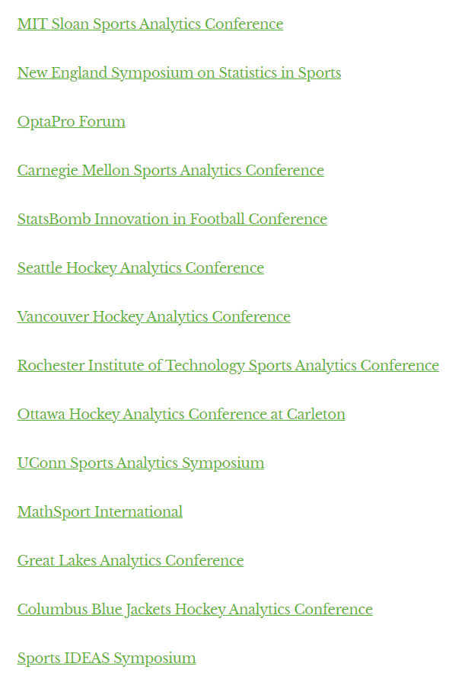
My Journey to Sports Statistics
How can you get into sports statistics?
Do analyses, write it up on personal blog
Pitch sports analytics websites you like
Promote on social media (Twitter, for now)
“Network”
Conferences – partial list
Notes:
I expect today’s presentation will be a teaching challenge, but by request I am focusing on my research today. I would just hope that none of this overshadows – especially in the students’ eyes – how important teaching and your success is to me. Agnes Scott prides itself on its undergraduate teaching, and I would hope I fit very well into that mission. I am excited to help develop an accessible, engaging, applied, active-learning-based, forward-thinking Epidemiology, Biostatistics, and broader Public Health curriculum

Slide 19
A Word on Luck
“You Make Your Own Luck”
Half-agree. You can put yourself in positions to get lucky, but sometimes shit just happens (good or bad)
Important to recognize role of luck in where I am
Privilege (white, male, cis, straight, middle-class childhood, etc.) is a huge part of luck
Source: https://media2.giphy.com/media/3o6EhVa1ER0rWULFAs/giphy.gif
Notes:
I expect today’s presentation will be a teaching challenge, but by request I am focusing on my research today. I would just hope that none of this overshadows – especially in the students’ eyes – how important teaching and your success is to me. Agnes Scott prides itself on its undergraduate teaching, and I would hope I fit very well into that mission. I am excited to help develop an accessible, engaging, applied, active-learning-based, forward-thinking Epidemiology, Biostatistics, and broader Public Health curriculum

Slide 20
Introductions (You)

Slide 21
Small Groups of 4: Who Are You?
Name
Where you’re from
Teams you root for? (If any of you says Patriots I swear to God…)
“Two truths and a lie”
Group votes – do not reveal what’s the lie, though!
Each person writes down info for one groupmate and will introduce them in a moment

Slide 22
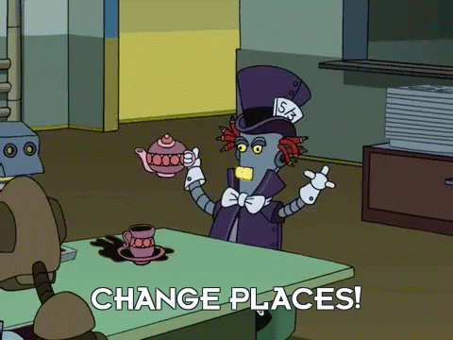
Small Groups of 4
One person stays put
Each of the others goes to a different group
Source: https://media.tenor.com/BU7jcFyIrPoAAAAC/futurama-change-places.gif

Slide 23
Small Groups of 4: Highlights
Share your favorite sports highlight with your group
Have fun!

Slide 24
Small Groups of 4
One person stays put
Each of the others goes to a different group you haven’t visited before
Source: https://media.tenor.com/BU7jcFyIrPoAAAAC/futurama-change-places.gif

Slide 25
Small Groups of 4: Immaculate Grid?
Play a round together!
Goal: fill in the whole grid and get the lowest rarity score
Choose any sport
https://www.immaculategrid.com/ or https://www.immaculategrid.io

Slide 26
Next Class
For next class:
Do the readings on Canvas
Install R and Rstudio (complete “Tutorial 0”)

Slide 27

Thanks!
Questions? zbinney@emory.edu, @binney_z on Twitter

Slide 28
Appendix: More on my Research

Slide 29
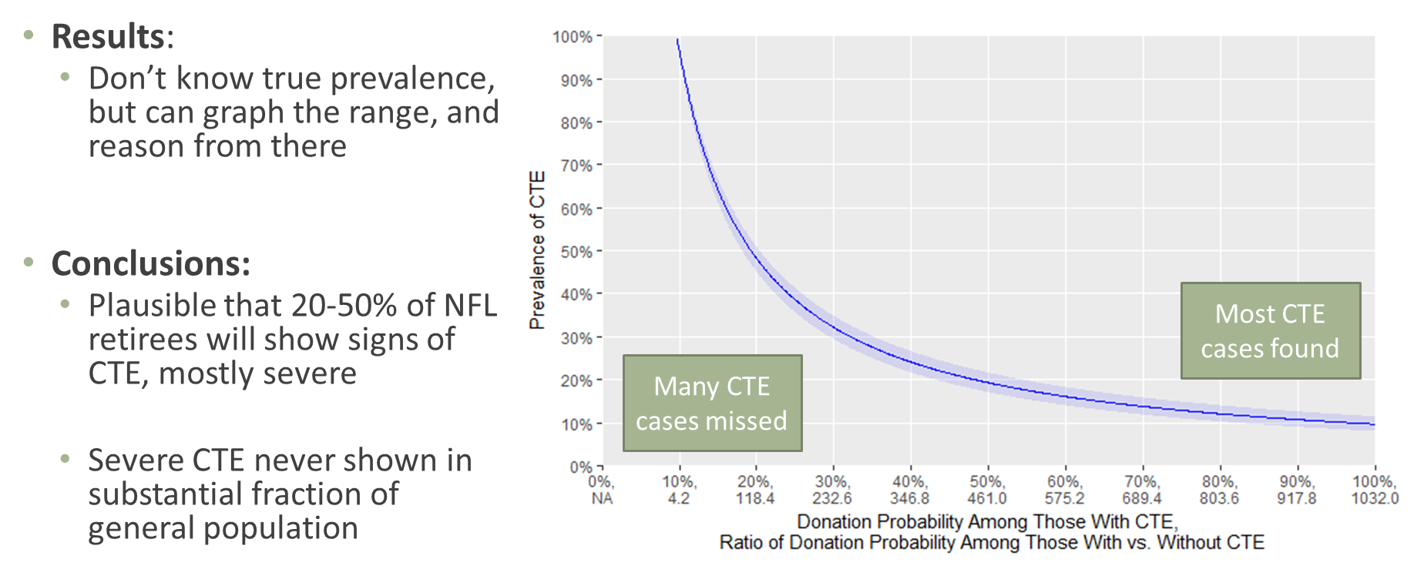
Sports Epidemiology
Public Work – chronic traumatic encephalopathy (CTE)
Problem: severely selected samples of dead ex-players who donated brains in CTE work
99% of donated brains had CTE != 99% of football players have CTE. But we know total # of players who died → possible donated brains. Use a little algebra and…
Source: https://www.nytimes.com/interactive/2017/07/25/sports/football/nfl-cte.html; https://n.neurology.org/content/92/1/43

Slide 30
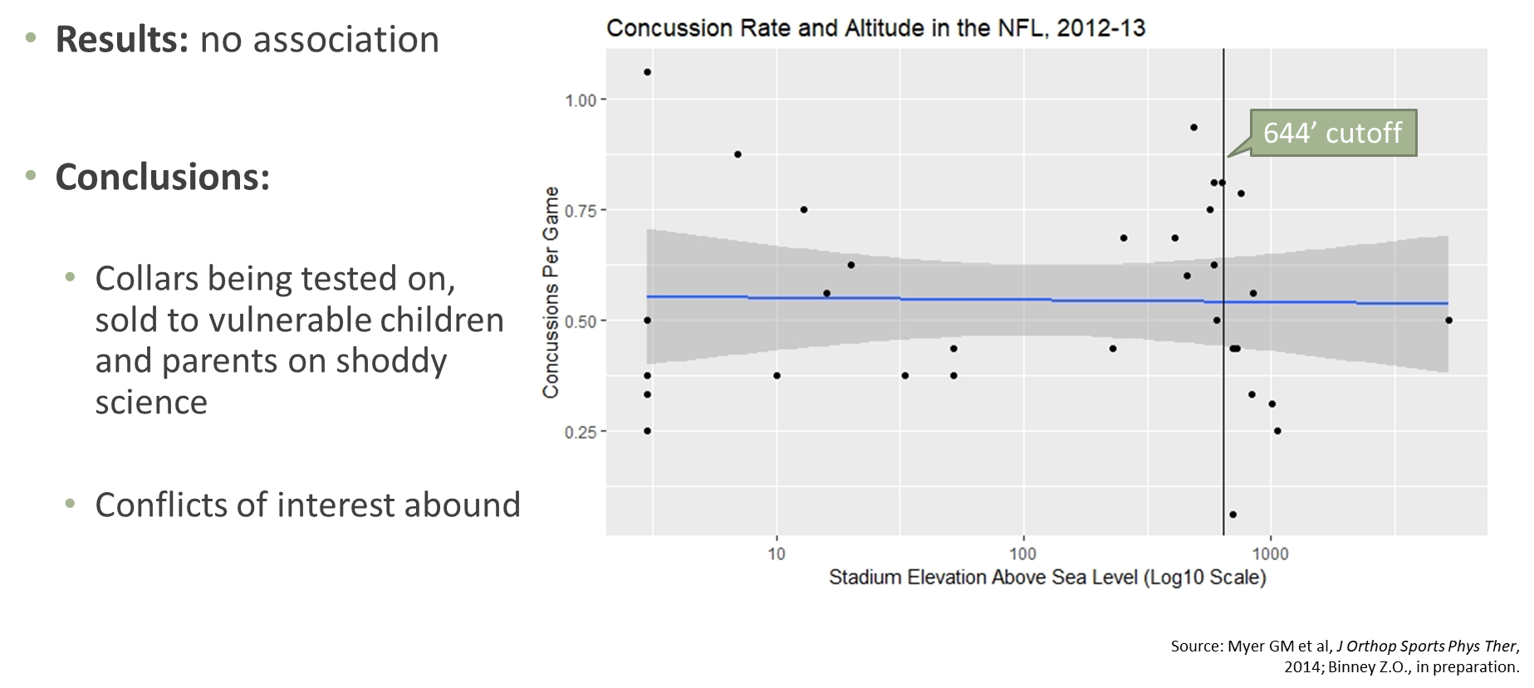
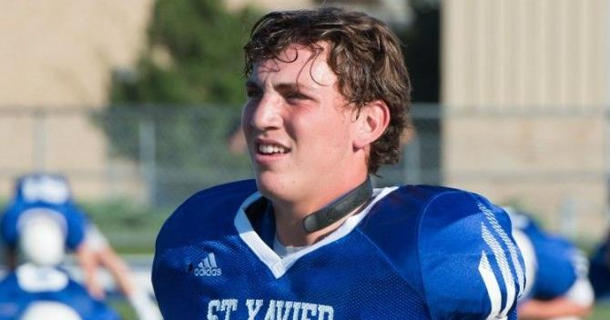
Sports Epidemiology
Public Work – bust snake oil
Claim: association between concussions and altitude (high vs. low) in NFL
Source: https://www.gannett-cdn.com/-mm-/0059de15fe182a2610bc8112ecfbb5bff2d47db6/c=0-0-749-423/local/-/media/2017/06/14/Cincinnati/Cincinnati/636330383188625054-qcollar.jpg?width=3200&height=1680&fit=crop
Notes:
I expect today’s presentation will be a teaching challenge, but by request I am focusing on my research today. I would just hope that none of this overshadows – especially in the students’ eyes – how important teaching and your success is to me. Agnes Scott prides itself on its undergraduate teaching, and I would hope I fit very well into that mission. I am excited to help develop an accessible, engaging, applied, active-learning-based, forward-thinking Epidemiology, Biostatistics, and broader Public Health curriculum

Slide 31
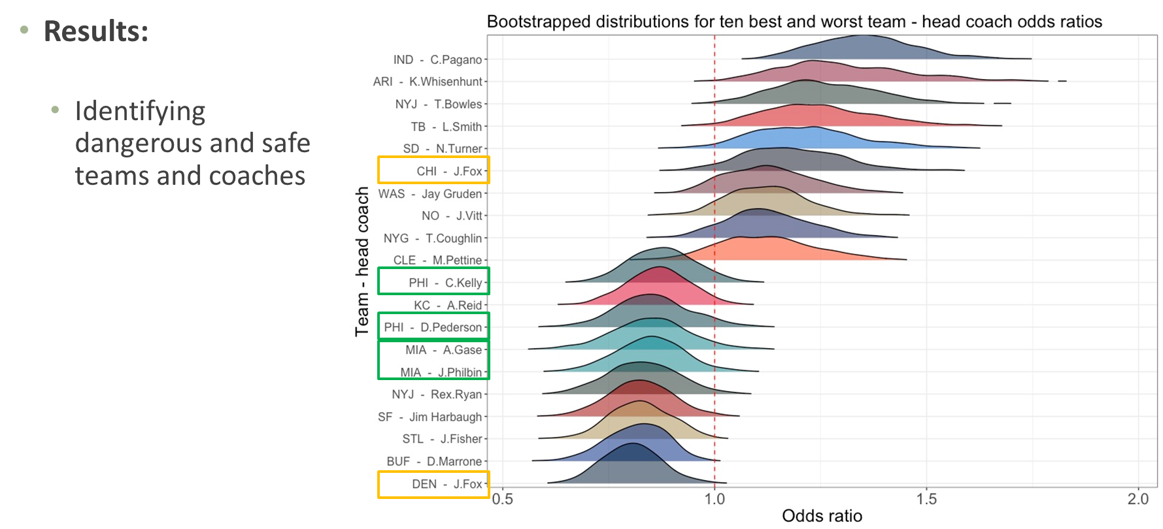
Sports Epidemiology
Public Work – identify NFL injury risk factors
Notes:
I expect today’s presentation will be a teaching challenge, but by request I am focusing on my research today. I would just hope that none of this overshadows – especially in the students’ eyes – how important teaching and your success is to me. Agnes Scott prides itself on its undergraduate teaching, and I would hope I fit very well into that mission. I am excited to help develop an accessible, engaging, applied, active-learning-based, forward-thinking Epidemiology, Biostatistics, and broader Public Health curriculum

Slide 32
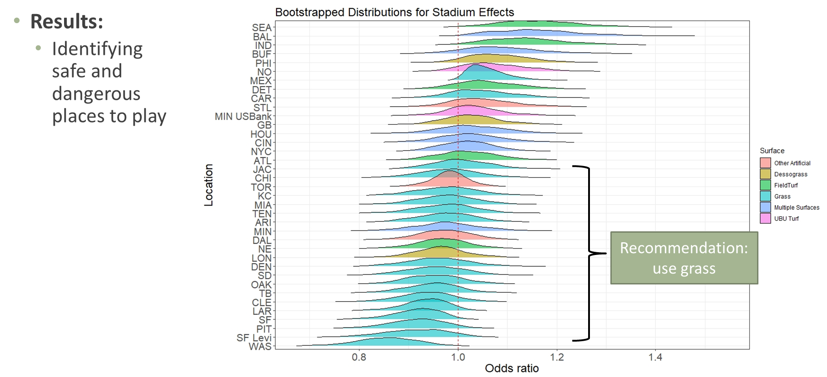
Sports Epidemiology
Public Work – identify NFL injury risk factors
Notes:
I expect today’s presentation will be a teaching challenge, but by request I am focusing on my research today. I would just hope that none of this overshadows – especially in the students’ eyes – how important teaching and your success is to me. Agnes Scott prides itself on its undergraduate teaching, and I would hope I fit very well into that mission. I am excited to help develop an accessible, engaging, applied, active-learning-based, forward-thinking Epidemiology, Biostatistics, and broader Public Health curriculum

Slide 33
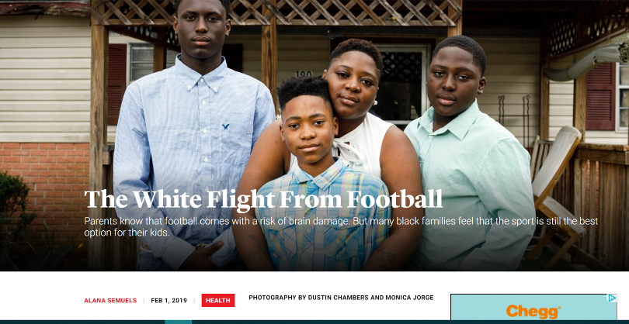
Children and Football
As we learn more about dangers to long-term health, who is left to play? Our most vulnerable children.
-6.6% nationwide in last decade
Declines in 40 total states; steepest declines in Rust Belt, northeast
Rising in south
NFL now >75% black
Source: The Atlantic (https://www.theatlantic.com/health/archive/2019/02/football-white-flight-racial-divide/581623/); https://www.theguardian.com/sport/2019/jan/30/high-school-football-numbers-drop-brain-trauma?CMP=share_btn_tw

Slide 34
Children and Football
HBO Real Sports: in Illinois from 2012-2017,
Players receiving public assistance
Total football players
+25%
-15%
Source: HBO Real Sports (https://www.youtube.com/watch?v=jwyWIcvHRi4&feature=youtu.be)

